Slide 1

Introduction to XML

Slide 2
About me
7 years of experience in localization industry
Specialized in software localization, xml technology, internal/external trainings, contact with business clients, implementation of new solutions for clients
Madcap of cutting edge technologies

Slide 3
Index
    Markup language – definition and genesis
    History of the XML Standard
    Most common usage
    Document Type Definitions (DTD)
    XML structure (basic informations)
    Well formadness and validation
    XML standards examples (DITA, SVG,)

Slide 4
Markup language – definition and genesis
The roots of markup languages
Information storage
Needs to have one complex standard (universal data format)
One content - multiple forms
Interpreting the data by machines – not people
Internet and online publication
4

Slide 5
Markup language – definition and genesis
Markup language – definition
It is a document format which, along with the text also
contains additional information that describes it.
This additional information are expressed by inline tags.
Those information contain for example appearance and meaning of the document fragments.
Markup is typically omitted from the text that is displayed for end-user. Markup dont contain any specific format information – so text formatting based on markups can be different depending on enviroment in which is displayed
Some markup languages, such as HTML, have presentation semantics, meaning that their specification prescribes how the structured data are to be presented, but other markup languages, like XML, have no predefined semantics.
5
Notes:
A markup language is a modern system for annotating a document in a way that is syntactically distinguishable from the text.
The idea and terminology evolved from the "marking up" of manuscripts, i.e., the revision instructions by editors, traditionally written with a blue pencil on authors' manuscripts.
Markup is typically omitted from the version of the text that is displayed for end-user consumption.
Some markup languages, such as HTML, have presentation semantics, meaning that their specification prescribes how the structured data are to be presented, but other markup languages, like XML, have no predefined semantics.

Slide 6
History of the XML Standard
Genealogy of formats and standards
GML
SGML
XML
SVG
DocBook
DITA
MathML
RDF
XHTML
and more…
HTML
6
Notes:
GML
SGML
HTML
XML → SVG, DITA, RDF, DocBook, MathML, XHTML and more…

Slide 7
History of the XML Standard
GML (1969)
GML was developed in the 1960s by Charles Goldfarb, Edward Mosher and Raymond Lorie (IBM)
GML is a set of macros that implement markup tags for the IBM text formatter (SCRIPT)
Using GML, a document is marked up with tags that define what the text is, in terms of paragraphs, headers, lists, tables. The document can then be automatically formatted for various devices simply by specifying a profile for the device (like printer). To change look of document you just simply change a profile.
Example of GML markups with text:
:h1.Chapter 1: Introduction
:p.GML supported hierarchical containers, such as
:ol
:li.Ordered lists (like this one),
:li.Unordered lists, and
:li.Definition lists
:eol. as well as simple structures.
7
Notes:
The initials stood for Goldfarb, Mosher and Lorie.

Slide 8
History of the XML Standard
SGML (1980)
SGML is succesor of GML ideas
SGML - Standard Generalized Markup Language
SGML is a document markup language; was originally designed to enable sharing of machine-readable large-project documents in government, law, and industry.
Developing SGML
  First version (draft) - 1980
  ISO standard version – 1986
  SGML (ENR) – 1996
  SGML (ENR+WWW or WebSGML) – 1998
8
Notes:
SGML is an ISO standard: "ISO 8879:1986 Information processing — Text and office systems — Standard Generalized Markup Language (SGML)", of which there are three versions:
Original SGML, which was accepted in October 1986, followed by a minor Technical Corrigendum.
SGML (ENR), in 1996, resulted from a Technical Corrigendum to add extended naming rules allowing arbitrary-language and -script markup.
SGML (ENR+WWW or WebSGML), in 1998, resulted from a Technical Corrigendum to better support XML and WWW requirements.
SGML is part of a trio of enabling ISO standards for electronic documents developed by ISO/IEC JTC1/SC34[1][2] (ISO/IEC Joint Technical Committee 1, Subcommittee 34 – Document description and processing languages) :
SGML (ISO 8879)—generalized markup language. SGML was reworked in 1998 into XML, a successful profile of SGML. Full SGML is rarely found or used in new projects.
DSSSL (ISO/IEC 10179)—document processing and styling language based on Scheme. DSSSL was reworked into W3C XSLT and XSL-FO which use an XML syntax. Nowadays, DSSSL is rarely used in new projects apart from Linux documentation.
HyTime—Generalized hypertext and scheduling.HyTime was partially reworked into W3C XLink. HyTime is rarely used in new projects.
First SGML application:
CALS language was primarily used to store technical documentation of military equipment for US Army. It was most well known for a table model that is a part of it. CALS table model is in use until today, and has also XML version (CALS – Computer-Aided Acquisition and Logistic Support, US Department of Defense, MIL-M-28001, February 1988).

Slide 9
History of the XML Standard
HTML
HyperText Markup Language (HTML) is the main markup language for displaying web pages and other information that can be displayed in a web browser.
Roots of HTML: Tim Berners-Lee, CERN, early 1980's,
Since 1989 – HTML used in Internet (several tags)
HTML 2.0 -1993 - defined as SGML application (added displaying
graphics, tables, multimedia files).
HTML 3.2 – 1997:
  lot of formatting tags directly in documents.
HTML 4 – 1999:
  pressure on structure and semantics,
  CSS instead of formatting tags and attributes.
HTML 5.0 – ????
9

Slide 10
History of the XML Standard
XML
1996 - World Wide Web Consortium (W3C) create work group for creation a new standard that will have power and flexibility of SGML and simplicity of HTML. 26 pages with specification of new format was presented (SGML specification had 500 pages) with name Extensible Markup Language (XML)
1997 - first application of new language – finally the first application was Channel Definition Format (CDF) created by Microsoft
1998 - the W3C approved Version 1.0 of the XML specification and a new language was born
10

Slide 11
History of the XML Standard
XHTML 1/2
XHTML (Extensible HyperText Markup Language) is a family of XML markup languages that mirror or extend versions of the widely used Hypertext Markup Language (HTML)
While HTML was defined as an application of SGML,
a very flexible markup language framework, XHTML is an application of XML, and has more restrictive form.
Because XHTML documents need to be well-formed, they can be parsed using standard XML parsers
11

Slide 12
History of the XML Standard
XHTML 2/2
More simply definition – XHTML is HTML but written with XML syntax and all XML rules:
HTML:
<br>
<p>This is a list:
<ul>
<li>item 1
<li>item 2
</ul>
<p align=center>Title</p>
XHTML:
<br/>
<p>This is a list:</p>
<ul>
<li>item 1</li>
<li>item 2</li>
</ul>
<p align="center">Title</p>
12

Slide 13


XML – Examples of application
Data storage (database structure)
Data interchange beetwen
applications/ modules/ systems
13

Slide 14
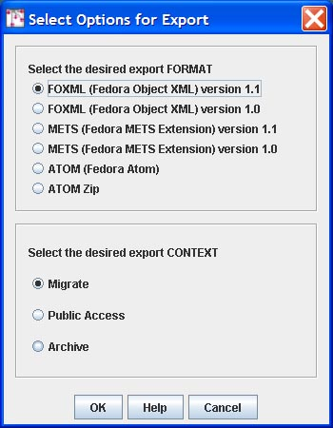
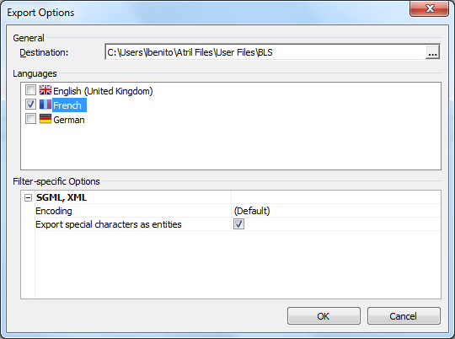
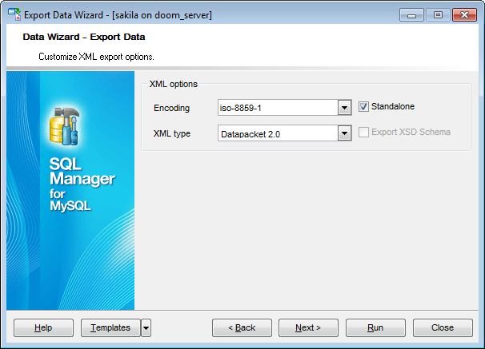
XML – Examples of application
Import/ export options for different platforms

Slide 15

XML – Examples of application
Web (like RSS protocol, web browsers, social media portals, communicators)

Slide 16
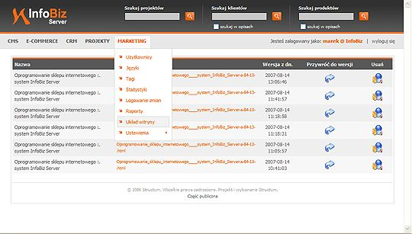

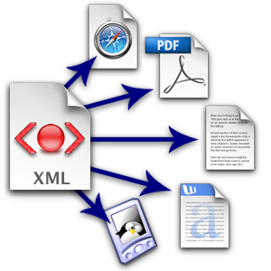
XML – Examples of application
Content and documentation managment
Publication for multiple formats

Slide 17
XML structure (elements, attributes, declarations)
XML structure
<?xml version="1.0">
<catalog>
<car year=„2007">
<manufacturer>Ford</manufacturer>
<model>Focus</model>
<description>The Ford Focus is a compact
car (C-segment in Europe) manufactured by the Ford Motor Company since 1998.</description>
</car>
<car year=„2011">
<manufacturer>Fiat</manufacturer>
<model>Panda</model>
<description>The Fiat Panda is a city car
from the Italian automobile manufacturer Fiat</description>
</car>
</catalog>
XML declaration
Root element
Attribute
Element
Starting tag
Ending tag
Content
17
Notes:
Each XML document begins with XML declaration, which specifies version of XML syntax, character encoding, etc.
All document content is contained in a single element, called root element. There must be exactly one root element. Root element contains other elements and text. Elements may have attributes, which describe certain properties of elements.
Each element begins with a start tag, and ends with an end tag.

Slide 18
XML structure (elements, attributes, declarations)
XML structure – logical structure
CATALOG
CAR
CAR
YEAR=„2007"
YEAR=„2011"
MANUFACTURER
MODEL
DESCRIPTION
MANUFACTURER
MODEL
DESCRIPTION
FORD
FOCUS
THE FORD…
FIAT
PANDA
THE FIAT…
18
Notes:
Logical structure – structure and content is presented as tree with nodes (elements, attributes and content)

Slide 19
XML structure - Document Type Definitions (DTD)
Document Type Definitions (DTD) 1/2
A DTD states what tags and attributes are used to describe content in an SGML, XML or HTML document and describes in which place which tag is allowed. Also which tags can appear within other tags
Using a DTD ensure that all the documentation is formatted the same way
Applications will use a document's DTD to properly read and display a document's contents
Changes in the format of the document can be easily made by modifying the DTD
DTD can also storage information about non standard entities (entity declarations) and external links to other DTDs or structural files
19

Slide 20
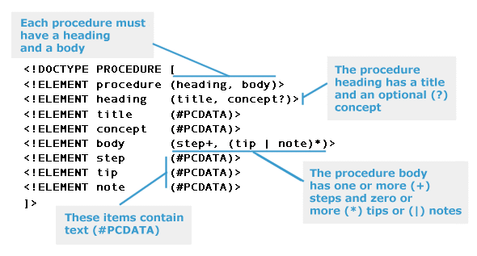
XML structure - Document Type Definitions (DTD)
Document Type Definitions (DTD) 2/2
20

Slide 21
XML structure - elements, attributes, declarations
XML structure – declaration 1/2
The XML declaration is a processing instruction that identifies the document as being XML. All XML documents should begin with an XML declaration.
<?xml version="version_number" encoding="encoding_declaration" standalone="standalone_status" ?>
<!DOCTYPE omg-content PUBLIC "-//OMG//DTD OMG-CONTENT V1.0//EN" "omg-content.dtd">
Always at the beginning of a document (first line, from the first character).
Can be skipped, if XML version is 1.0, and encoding is
UTF-8 version 1.0 and UTF-8 encoding are default settings
for all xml documents
21

Slide 22
XML structure - elements, attributes, declarations
XML structure – declaration 2/2 (Standalone)
Internal DTD:
The document type declaration must be placed between the XML declaration and the first element (root element) in the document.
The keyword DOCTYPE must be followed by the name of the root element in the XML document.
The keyword DOCTYPE must be in upper case.
External DTD:
If any elements, attributes, or entities that are referenced or defined in an external DTD are used in the XML document, standalone="no" must be included in the XML declaration.
External DTDs are useful for creating a common DTD that can be shared between multiple documents. Any changes made to the external DTD automatically updates all the documents that reference this DTD.
There are two types of external DTDs: private, and public.
22

Slide 23
XML structure - elements, attributes, declarations
XML structure – Elements and attributes 1/2
❑ <first> is a start-tag
❑ </first> is an end-tag
❑ <first>John</first> is an element
❑ <first id=1> is an attribute
The text between the start-tag and end-tag of an element is called the element content.
Document contains exactly one root element.
Elements may contain subelements and text nodes.
Attribute value must be in single or double quotes.
A given element cannot have two attributes with the same name.
23

Slide 24
XML structure - elements, attributes, declarations
XML structure – Elements and attributes 2/2
Information usually put in elements:
  content (semantic elements, e.g.: surname, medicine name, address),
  structure (e.g.: chapter, paragraph, title, list),
  search info (e.g.: index item, glossary item),
  references (e.g.: hyperlinks, notes, footnotes).
Information usually put in attributes:
  metadata (e.g.: measuerment unit, weight, language, priority),
  identifiers and references to identifiers.
24

Slide 25
Well formadness and validation
Well formadness
A document built according to XML syntax rules is called
well-formed.
Basic well-formedness rules:
  each start tag must have equivalent end-tag
  elements must be properly nested,
  attribute values must be in single or double quotes,
  a given element cannot have more than one attribute of a same name
Well-formedness of documents is performed by parsers.
25

Slide 26
Well formadness and validation
Validation
An XML document is valid if its content matches its document type definition (DTD) of allowable elements, attributes, element orders, nesting and other document pieces.
Validation also perform well formed check – becouse document can`t be valid if he is not well formed (he is not build with XML rules and syntax).
For correct validation process we need all DTD files, external styles, mod files, custom entity definitions
26

Slide 27
XML standards
XML standards (examples)
Content management and publishing:
  DocBook
  XHTML
  DITA
Metadata, knowledge maps:
  RSS
  Atom
Graphics:
  SVG
27

Slide 28
XML standards
XML standards – DITA 1/2
Core of standard presented by IBM in 2001
OASIS present first official version of standard (1.0 – 2005)
Current version – 1.5.3 (2011)
The Darwin Information Typing Architecture (DITA) is an OASIS standard XML data model for authoring and publishing.
Many third party tools support authoring, including Adobe FrameMaker, XMetaL, Arbortext, Quark XML Author, Oxygen XML Editor, easyDITA, and SDL Xopus
DITA content is created as small topic items, rather than long books or chapters. A DITA map contains links to topics, organized in the sequence (which may be hierarchical) in which they are intended to appear in finished documents.
Documents can be organised in ditamap files (table of content type file) Conception of ditamap file is very similiar to book file in Adobe Framemaker or Adobe Indesign
28

Slide 29
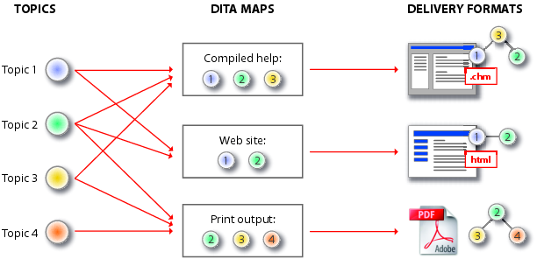
XML standards
XML standards – DITA 2/2
One of the main features is reusing of content (small modules can be easly reused in other ditamap files or by special scripts or programs – user can easly create different types of materials from the same pack of files:
29

Slide 30

XML standards
XML standards – SVG
SVG (Scalable Vector Graphics) is a W3C recommendation/ standard – the newest version is 1.1 second edition (published in 2011)
SVG is still developing – completly reworked version (that will support most of the highly used web standards (like CSS, HTML5) will be ready in 2014
SVG is used to define vector-based graphics for the Web
SVG defines the graphics in XML format
SVG graphics do NOT lose any quality if they are zoomed or resized
Every element and every attribute in SVG files can be animated
SVG format is supported by most of web/design applications (like web browsers, graphics editor like Adobe Illustrator, Corel Draw) – but can be also edited in any text/xml editor
Code Example
<g fill="green" stroke="black" >
<rect x="10" y="10" rx="5" ry="5" width="80" height="80" />
<g fill="blue" rx="10" ry="10" stroke-width="4" >
<rect x="110" y="110" width="80" height="80" />
</g>
</g>
30

